Slide 1

MeetMinder Asophisticated meeting scheduling system designed for modern professional businesses
Database System Project
Haolin Li & Baixi Guo

Slide 2
Implementation Detail
Front-end: VUE
Progressive framework that's easy to integrate into projects.
Simple and intuitive API.
Back-end: Python
Rapid Development: allow for quick setup and development.
automatic admin interface for database management.
Database: MySQL
Reliable and widely used in various industries.
Good performance and scalability.
Open-source with a vast user base.
Django has its ORM, which makes database interactions very intuitive.

Slide 3
Essential User Cases
Create Meeting: Allow a user to create a new meeting.
View Meeting: View the details of a specific meeting.
Attendance to Meeting: Allow attendees to confirm or decline their attendance for a meeting.
Send Notification: Automatically notify attendees about meeting details, changes, or cancellations.

Slide 4
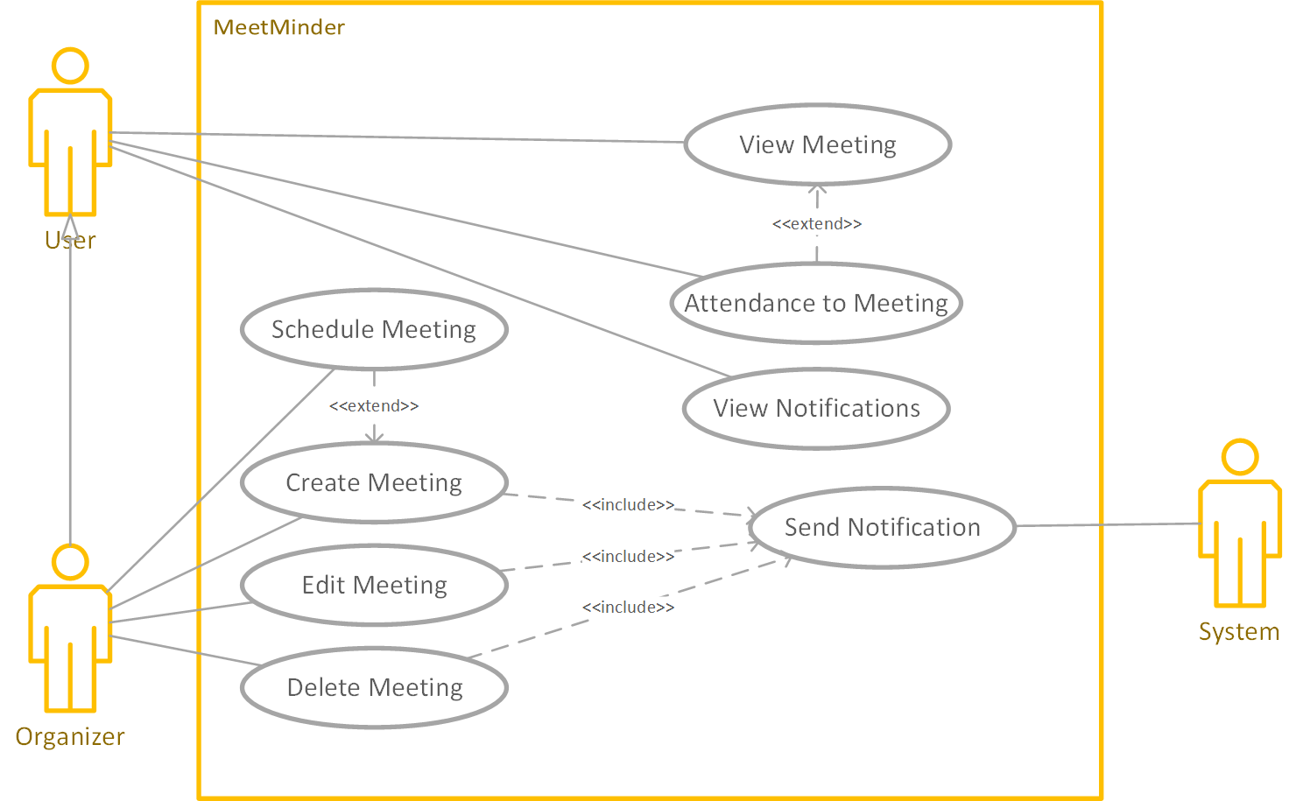
UML Diagram

Slide 5
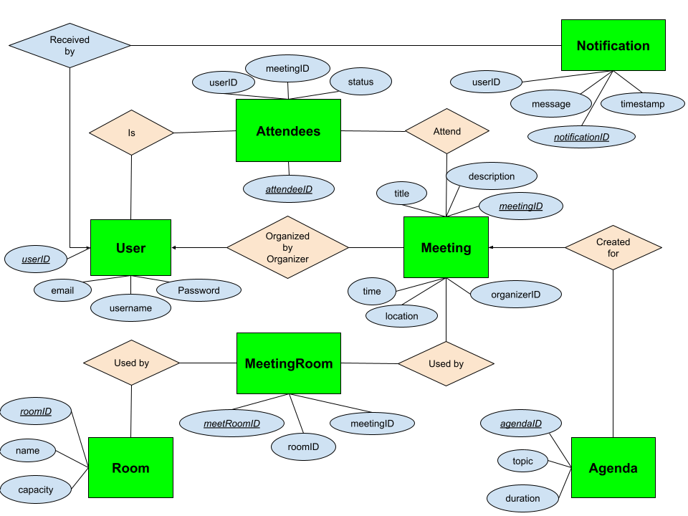
E/R Diagram
Notes:
https://docs.google.com/drawings/d/11M2C9E-8Uw9ztWXeJKKME3uu0mHF5TyH48-VzlBtQCE/edit?usp=share_link

Slide 6
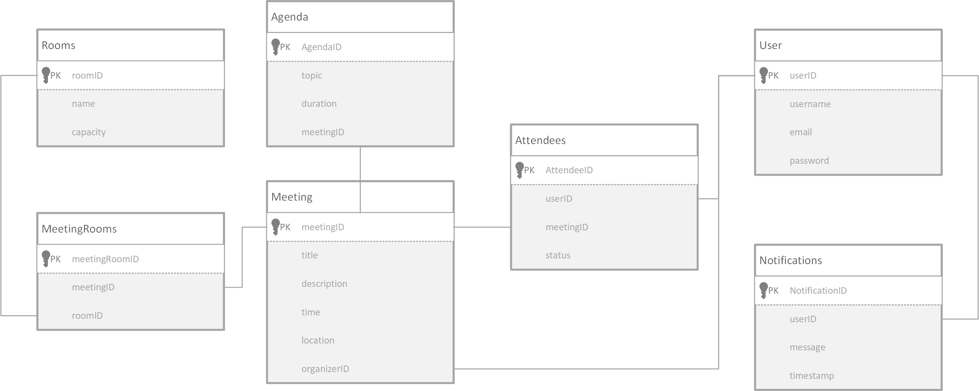
Relational Schema

Slide 7
Thanks
Github repository: https://github.com/cnlhl/CSE111-project.git

